Slide 1
Data Market Implementation using Online Learning
Shiuli Subhra Ghosh
Suman Roy
Chennai Mathematical Institute

Slide 2
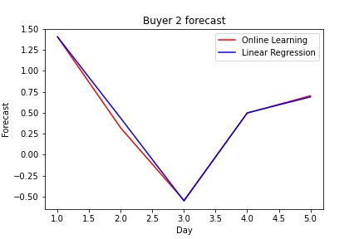
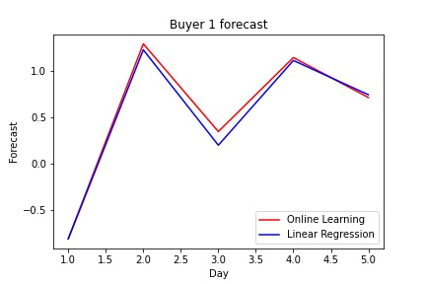
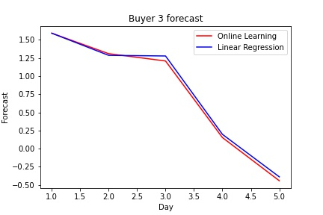
Comparison of Online and Off-line learning

Slide 3
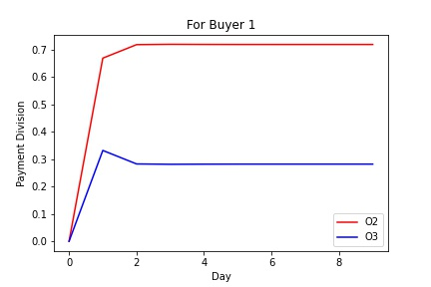
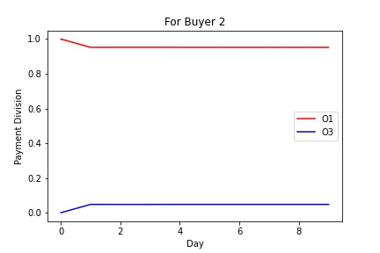
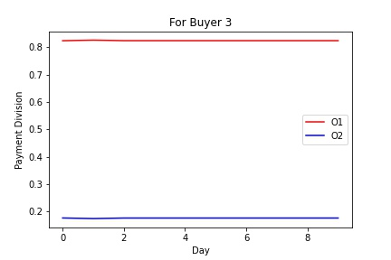
Comparison of Payment Division using Online Learning

